Slide 1
AI- Philosophy, Psychology, Engineering
Understanding the nature of thought and the nature of intelligence and building software to model how thinking might work.
Understanding the mechanics of the human brain and mental processes.
Building algorithms to perform humanlike tasks.

Slide 2
Some Game AI/DM
Know When to Walk Away, Know When to Run
Expanding the Engagement Decision
Matching Punches
Dueling Rocket Launchers
Scouting the Enemy
Counting the Enemy
The Tortoise and the Harried
Protecting the Barracks
Settlers and Warriors
Taking Fire
Building Soldiers
Declining Health
How Many Troops?
The Engagement Decision Revisited
Wizardry and Wands
Hippocratic Morals
How Much Weight?
Are We There Yet?
Who’s Next?
Which Dude to Kill?
Dudes Revisited 403
Flotilla of Futility

Slide 3
Game AI?
“It’s what makes the character walk toward me.”
“It’s what makes the enemy shoot at me.”
“It’s what makes the animation change from ‘idle’ to ‘attack.’”
“A game is a series of interesting choices.” Sid Maier

Slide 4
AI based on HI
movement AI
decision making AI,
strategic AI
Example:
programming the human intelligence – Indian road driver.

Slide 5
DM - Choices
Games are all about choices
DM is all about perception and calculation
Strategy is all about DM by vying the odds
Payoff is all about Strategy based DM with choices being the most maximal (not Optimal as in traditional AI)

Slide 6
We cover …
Game playing
Mini-max algorithm
Game trees
Optimization
Heuristics search
Alpha-beta pruning

Slide 7
Human Behavior models in Games – behavioral game theory
Designing
Measuring
There are four prominent models of actual rather than idealized Human Behavior:
(initial play in simultaneous move games)
Nash Equilibrium
Quantal response equilibrium (QRE; McKelvey and Palfrey, 1995)
level-k (Costa-Gomes et al., 2001; Nagel, 1995)
Cognitive Hierarchy (Camerer et al., 2004)

Slide 8
Quantal response equilibrium
Players are assumed to make errors in choosing which pure strategy to play. The probability of any particular strategy being chosen is positively related to the payoff from that strategy.
Example: commonly discussed is a 1981 game theory called ‘Centipede’.

Slide 9
Level –k
K-level thinking refers to a class of logic problems in which all actors are perfectly rational and possess infinite intelligence
level-k strategic thinking adopts a best response to beliefs about other players, but those beliefs are based on simplified models of other players. The level-k model describes subjects' initial responses to games significantly better than equilibrium model in a wide range of situations.
Example: Number guessing between 1-100 . The winner is the person whose number is closest to 2/3 times the average of all chosen numbers

Slide 10
Are players rational?
– What does “rationality” imply in this game?
– How should a rational player behave in a population in which not everyone is perfectly rational?

Slide 11
Depth of reasoning - The winner is the person whose number is closest to 2/3 times the average of all chosen numbers
1. I think the other players will play 50, so I will play the best response to 50, i.e 33 1/3
2 I think the other players think everyone will play 50 and so will play 33 1/3 . I will therefore play the best response to this, i.e. 22 2/9.
3 I think that the other players will initially think that everyone will play 50, and will consider playing 33 1/3. . However, they will think that others have done the same reasoning, and will therefore play 22 2/9. . I will best respond to this and play 14 22 /27
Check the class average….

Slide 12
K-level
Game theory: The study of strategic decision making
Your outcome depends on your own actions and the actions of others
Standard tool for prediction: Nash Equilibrium
No player has incentive to deviate given the actions of others
But Nash Equilibrium has some problems
Play of experimental subjects systematically violate its predictions
Can be very complex to calculate
Assumes a high degree of rationality on the part of subject
Assumes that THEY assume a high degree of rationality on the part of others
Level K model tries to deal with both of these problems

Slide 13
Cognitive Hierarchy
Assumes that players in strategic games base their decisions on their predictions about the likely actions of other players.
Example: centipede game
In its basic form, CHT implies that each player believes that he or she is the most sophisticated person in the game. Players at some level k will neglect the fact that other players could also be level-k, or even higher.

Slide 14
Minimax
Coding Human thinking: “if a Human make this move, then his/her opponent can only make two moves, and each of those would let human win. So this is the right move to make.”
Applied to two player games with perfect information
Each game state is an input to an evaluation function, which assigns a value to that state
The value is common to both players, and one person tries to minimize the value, while the other tries to maximize it
To keep the tree size tractable, could limit search depth or prune branches
End of game detection at end of every turn

Slide 15
Nash Equilibrium
A group of players are in Nash equilibrium if each one is making the best decision that he or she can, taking into account the decisions of the others.
Or :
“If there is a set of strategies with the property that no player can benefit by changing her strategy while the other players keep their strategies unchanged, then that set of strategies and the corresponding payoffs constitute the Nash Equilibrium”
originally framed by Merrill Flood and Melvin Dresher in 1950.
Albert W. Tucker - Prisoner’s Dilemma

Slide 16
Strategy games - Nash Equi in Games
A game consists of the following three elements:
1. A set of players,
2. A set of actions (or pure-strategies) available to each player, and
3. A payoff (or utility) function for each player.

Slide 17
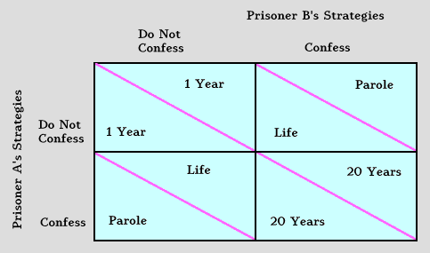
Minimax & Nash Equi
Driver B
 | Swerve | Drive Straight
Swerve | 2 | 1
Drive Straight | 3 | 0
Called the “Game of Chicken”
Driver A
2
3
1
0
Nash Equi
If A knows B will confess - A will confess
If A knows B will not confess - A will also not confess
If A knows B will swerve - A will go straight
If A knows B will not swerve - A will swerve
Which is the worst mutual payoff in the prisoner’s dilemma? – it’s a unique Nash Equi.
Notes:
Condition not met when : An example would be a player suddenly putting the car into reverse in the game of chicken, ensuring a no-loss no-win scenario. How does chicken differ from the prisoner's dilemma? Mutual defection (the crash when both players drive straight) is the most feared outcome in chicken. In the prisoner's dilemma, cooperation while the other player defects (being the sucker) is the worst outcome.
The players of a prisoner's dilemma are better off defecting, no matter what the other does. SAVE YOURSELF, without knowing what the opponent would do, but assume that he/she will confess.
Chicken run: Both want to do the opposite of what the other wants.
One is inclined to view the other player's decision as a given (possibly the other prisoner has already spilled his guts, and the police are withholding this information). Then the question becomes, why not take the course that is guaranteed to produce the higher payoff?
17

Slide 18
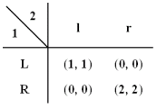
Pure Strategy Nash Equilibrium
A pure-strategy Nash equilibrium is an action profile with the property that no single player can obtain a higher payoff by deviating unilaterally from this profile

Slide 19
Nash Equilibrium in Mixed Strategies
 | Player 2
Player 1 | r | p | s
R | (0,0) | (-1,1) | (1,-1)
P | (1,-1) | (0,0) | (-1,1)
S | (-1,1) | (1,-1) | (0,0)
In a pure strategy a player chooses an action for sure, whereas in a mixed strategy, s/he chooses a probability distribution over the set of actions available.

Slide 20
Strategy games – full information based on MinMax One example: Tic Tac Toe

Slide 21
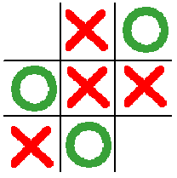
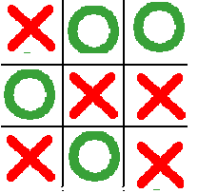
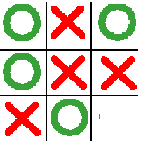

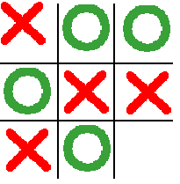
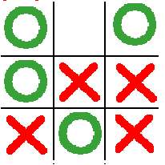
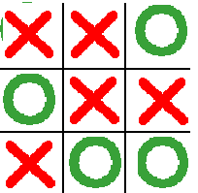
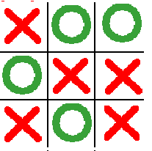
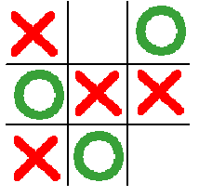
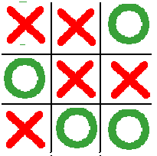
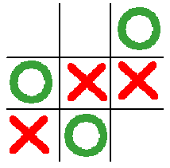
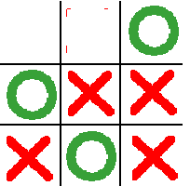
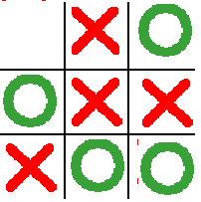
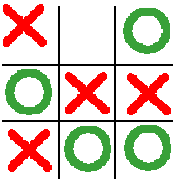
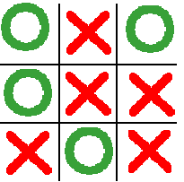

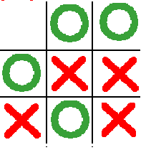
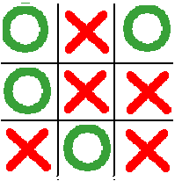
A Tic Tac Toe Game Tree
moves
moves
moves

Slide 22
Optimization
Heuristics
A heuristic is an approximation that is typically fast and used to aid in optimization problems.
In this context, heuristics are used to “rate” board positions based on local information.
For example, in Chess I can “rate” a position by examining who has more pieces. The difference in black’s and white’s pieces would be the evaluation of the position.

Slide 23
AI- Philosophy, Psychology, Engineering
Understanding the nature of thought and the nature of intelligence and building software to model how thinking might work.
Understanding the mechanics of the human brain and mental processes.
Building algorithms to perform humanlike tasks.

Slide 24
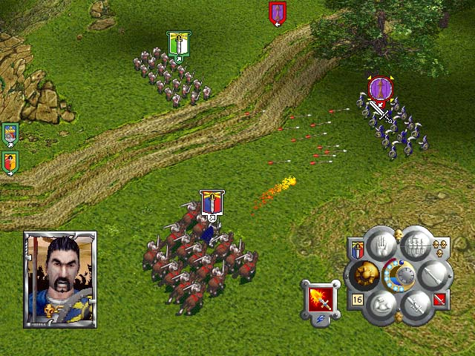
AI task into three sections: movement, decision
making, and strategy
AI gets given processor time
Execution management
AI gets its
information
AI has implications for
related technologies
Group AI
Strategy
Content creation
Character AI
World interface
Scripting
Decision making
Movement
Animation, Physics
AI gets turned into on-screen action

Slide 25
cognitive game
Reasoning techniques for games
- search
or
- Statistical inference
In search: minmax/alpha-beta pruning, adversary model, evolutionary algo’s….
In statistical inference: Bayesian networks, HMM

Slide 26
Two Fundamental Types of Intelligence usually applied in game (play)
Search vs. Non-Search
non-search: amount of computation is predictable
– e.g., decision trees, state machines
search: upper bound depends on size of search space(often large)
– e.g., minimax, planning
Where’s the “knowledge”?
non-search: in the code logic (or external tables) or human memory.
search: in state evaluation and search order functions

Slide 27
Alpha-Beta pruning
• Basic idea: prune away branches that cannot possibly influence the final decision
Search deeper in the same amount of time
• Similar to the Branch-and-Bound search (two searches in parallel: MAX and MIN)

Slide 28
Adversary modeling: Modeling a Human Opponent
Visual Memory
- proximity, similarity, continuation and symmetry.
Textual memory
- Rote, verbatim, order, timing
Chase and Simon

Slide 29
Evolutionary algo’s
Create smarter agents through mutation and crossover.
evolutionary algorithms seek to create stronger or smarter programs by mimicking the principles of natural selection and of general biology. The losers are destroyed while the winners are retained. In place of the losers, modified copies of the winners are also created.
Such programming techniques have been used frequently in fields such as manufacturing, circuit-board design, and of course, chess and Go
Kojima, et. al. An Evolutionary Algorithm Extended by Ecological Analogy to
the Game of Go. Proceedings 15 Intl. Joint Conf. on AI, 1997.

Slide 30
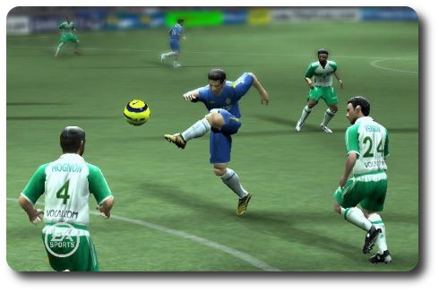
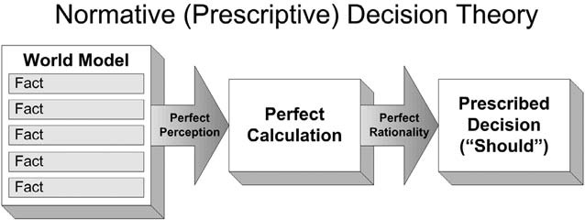
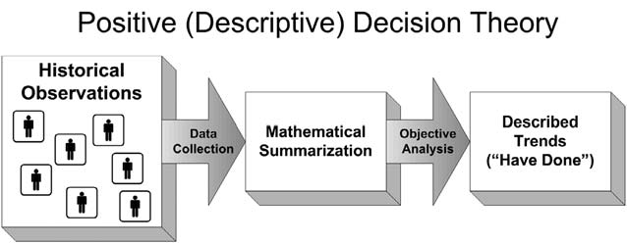
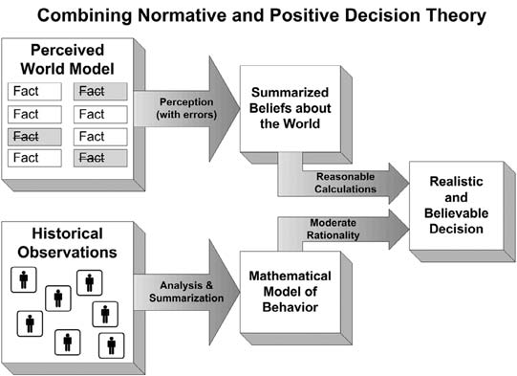
Decision making
Rational & Irrational
has been done
A pathfinding algorithm uses all four of the above criteria
and returns the path that an agent should take.
should be done
Positive decision theory uses historical
observations of behavior,
and summarizes and analyzes
that data to express what has been done
in the past.
Combining normative and positive decision theory takes the
limited world model perceived by an agent, adds the potential for errors, and
creates a belief about the world.

Slide 31
Tag Hunt
You’re player 1, hunting a deer with player 2. In order to catch the deer, both players must choose C1. But rabbits run through the woods. Each of you could be distracted and choose to just catch a rabbit by yourself instead (C2).
What’s rational?

Slide 32
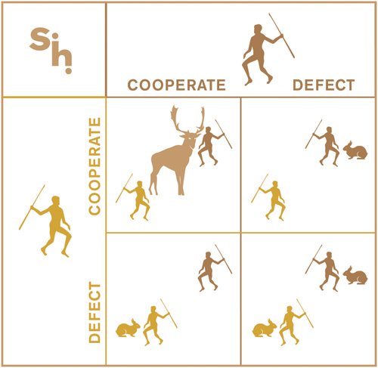
Payoff Matrix for Stag Hunt
Player 2
C1
C2
(4,4) | (0,2)
(2,0) | (2,2)
C1
Player 1
C2
What is the rational choice to make?

Slide 33
Finally…game strategy to real Life
Stag Hunt – extending this to:
Each country generally believes that the world would be better if no countries possessed nuclear weapons. However, the temptation to build up a nuclear arsenal arises because each country is afraid that other countries may stash nuclear warheads and undermine international security.

Slide 34
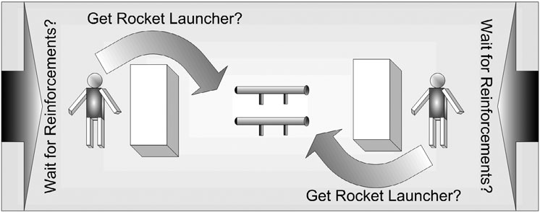
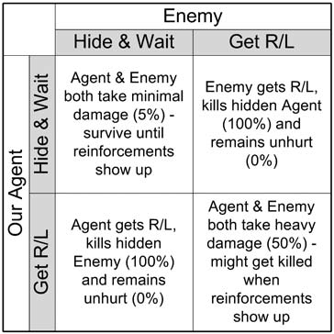
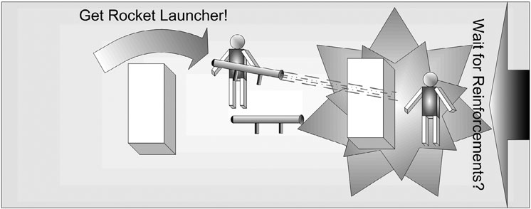
Another real-life situation?
The scenario of one agent rushing to get the rocket launcher while the other one hides is analogous to the Prisoner’s Dilemma scenario of one prisoner betraying
Source: Behavioral mathematics for Game AI, by Dave Mark

Slide 35
Rational & Irrational behavior
Buy groceries 2-3 times a day or once a week.
Latter leads to waste of food – buy more than required.

Slide 36
Rational and Irrational
In Game Theory these words have not the usual meanings
Rational - A choice that seeks for the maximal utility of the player
Irrational - Other choices allow a higher utility if the other players behave rationally

Slide 37
Irrationality I: Lower Gains
Ultimatum game
Two agents have 100 euros to divide among themselves
• I proposes a division
• if II accepts the proposal, then this is the final payoff
• if II rejects the proposal, then the final payoff is zero for both agents
A ”rational” choice for agent II is to accept whatever proposal, consequently the unique ”rational”
choice for agent I is 99 for himself and 1 for agent II

Slide 38
SOAR – is an inference engine for the intelligent agents
The inference engine constantly loops through :
1. Perceive: Accept sensor information from the game
2. Think: Select and execute relevant knowledge
3. Act: Execute internal and external actions

Slide 39
Games using SOAR
In Quake II and Descent 3 the standard Soar knowledge representation of a hierarchy of operators each implemented by multiple production rules is used.
For example, the toplevel operators in a Quake II or Descent 3 agent might
include attack, explore, retreat and wander.
Sub-operators of the top-level attack operator could include different styles
of attacking, such as pop-out-attack or face-enemy.
The operators at the bottom of the hierarchy are atomic steps and actions that implement the operators above, such as shoot, move-to-door and stop moving.

Slide 40
The basis of SOAR
A cognitive architecture as a theory of the fixed mechanisms and structures that underlie human cognition?
The Soar theory posits that cognitive behavior has at least the following characteristics (Newell, 1990):
1. It is goal-oriented. we don’t stumble through life.
2. It takes place in a rich, complex, detailed environment. the world we perceive and act on is not a simple one.
3. It requires a large amount of knowledge.: example, knowledge required to solve an equation.
4. It requires the use of symbols and abstractions.- our internal representations are 'symbols' , How do you know its a chicken?
5. It is flexible, and a function of the environment. - thinking in step with the world.
6. It requires learning from the environment and experience – learning from childhood to adult life.

Slide 41
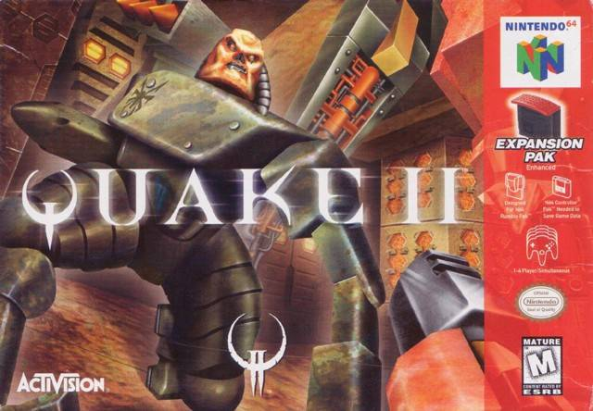
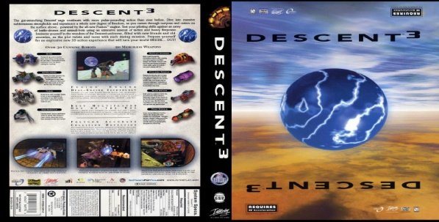
SOAR – a cognitive game engine
University of Michigan
Collaboration with Quake II and Descent 3
“the main goal of the Soar/Games project is to make games more fun by making the agents in games more intelligent.”

Slide 42
SOAR Engine Interface
Soar/Quake II
– 80 Sensors
• Agent
• Enemies
• Objects
• Path nodes
• Map Info
– 20 Actions
• Movement
• Weapons
• Inventory

Slide 43
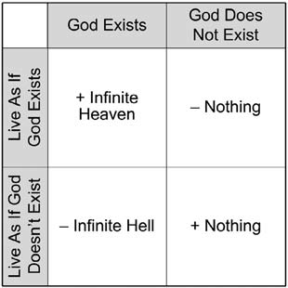
Matching pennies
Matching Punches
PRISONER’S DILEMMA
THE PIRATE GAME
Guess Two-Thirds of the Average
The Monty Hall Problem
PASCAL’S WAGER
A futuristic outcome
(what we do not know now)
The scoring matrix for Pascal’s Wager. Pascal used these options
and outcomes to determine that it was better to live as if God exists.

Slide 44
 | Attendance matters | Attendance does not matter
Attend as IF attendance matters | Yipeeeeee!!! | Not fair at all!!
Don’t Attend as IF attendance does NOT matter | What the heck?!!! | gained lots of free time!
A pure strategy is a complete definition of what a player should do at any given
time. That is, if you play this way, you will win (or at least will maximize your
chances of doing so) – so what is the pure strategy in the above case?? Or even better – is there one??
Actually, I think what you guys apply is mixed strategy. In this approach,
you select between a variety of strategies that are available to you. Often,
you can assign probabilities to these decisions to select which one you can do.

Slide 45
MEMORY, PERCEPTION, ACTION, AND COGNITION
Dichotomy between general knowledge and specific applications of that knowledge is captured in Soar by the existence of two different types of memory.
WM is represented as a set of the features and values that make up the current state (and substates), which might include representations of the current goal, problem space, and operator.
Important for controlled behavior
Long term memories
Procedural
Semantic/factual
Episodic
Working Memory
Diff between WM/LTM?
Decision procedure
Perception
Action
BODY

Slide 46
Intuitive Physics Engine
Analysizes based on basic parameters: geometries, velocities, forces on objects like gravity…that is represents the world with a reasonable degree of physical fidelity.
Three key design elements render it distinct from an ideal physicist’s approach:
1. First, the IPE is based on simulation: Rather than manipulating symbolic equations to obtain analytic solutions, it represents mechanics procedurally and generates predicted states based on initial ones by recursively applying elementary physical
rules over short time intervals.
2. Is probabilistic rather than deterministic: stochastic (Monte Carlo) simulations that represent uncertainty about the scene’s state and force dynamics and is thereby robust to the noisy and incomplete information provided by perception.
3. Inherently approximate: In its mechanics rules and representations of objects,
forces, and probabilities, it trades precision and veridicality for speed, generality, and the ability to make predictions that are good enough for the purposes of everyday activities.
Battaglia et al., PNAS, 2013

